Slide 1
Student
Institution
Instructor
Course
Date

Slide 2
Individual Differences in Workplace

Slide 3
Introduction: Individual differences
Individual differences can be defined as the enduring characteristics that are used in distinguishing one organism from another.
The characteristics are stable over time and across various situations; they include behavioral, cognitive, affective and genetic traits that are ascribed to animals or peoples.
It’s very important for the people in working in an organization to understand individual differences because they influence behaviors, thoughts and feelings.

Slide 4
Importance of individual differences
People with different individual differences perceive and behave differently.
Individual differences brings in good qualities to the workplace such as good values, uniqueness, moods, emotions, (Moore, 2008).
People with different personalities also interact different with coworkers, subordinates and customers.
They also react differently to the directives given.
Individual differences explains why some people in workplace will embrace change while others will be fearful of it.
It also explains why some employees need close supervision while others need less supervision in order to be more productive.
Moreover, individual differences helps the manager to understand why some workers learn new tasks more effective than the others.

Slide 5
Individual differences to managerial practice.
It’s a requirement for any effective managerial practice to recognize the individual differences and when feasible, they must be taken into consideration while carrying out the managerial practice of the organization.

Slide 6
Types of individual differences
Physical differences-these include height, color of skin, fatness or thinness and strength of the body.
Differences in intelligence-people are classified from super-normal with I.Q of 120 to the idiots with I.Q of less than 50.
Differences in Attitudes-different employees have different attitudes towards objects, people, authority and institutions.
Differences in achievements- Different employees will vary in terms of achievements according to their experiences, educational backgrounds and interests.
Differences in motor ability-this difference is basically brought up by differences in ages as well as fitness. Some employees can perform mechanical tasks easily while others experience difficulty while performing the same task.
Differences in account of sex- men and women differ in terms of motor ability, memory, handwriting, logics and languages.
Other differences include racial, nationality, economic status, interests and emotional differences.

Slide 7
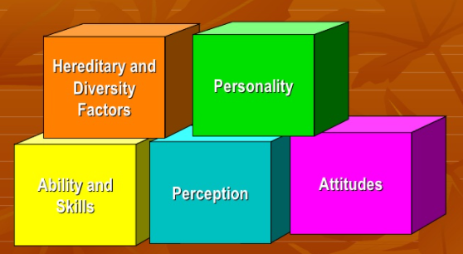
Individual Differences Influencing Workplace

Slide 8
Disability Diversities
These are the individual differences that are brought up due to physical or mental impairment that substantially limits one or more of his major life activities, (Lucas, & Friedrich, 2005).
As a manager or the group leader, you must restructure the work and modify schedule to cater for those with such personality traits.
If the disability is identified to be more severe, the work should be reassigned to new employees are fit.

Slide 9
How to Increase Effectiveness in Changing Attitudes
Concentrate on gradually changing the attitude towards something over a period of time.
Identify the values and beliefs that are part of the attitude that you have on something or somebody and come up with information that is going to alter those beliefs and values.
Make the setting for changing the behavior or attitude as enjoyable as possible.
Identify the reasons as to why you need to change the attitude.

Slide 10
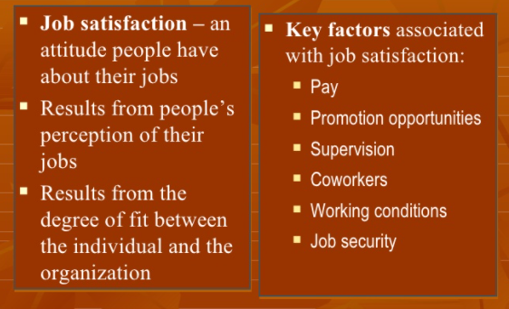
Attitudes and Job Satisfaction

Slide 11
Strategic Training Program
The strategic training program should be carried out in workplace to educate the employees about the individual differences and show them how they should use their multicultural dimensions in workplace to enhance organizational effectiveness.
The strategic training program will help in organizing a diverse workplace to;
Treat individuals equally.
Set standards on criteria
Be open minded to understand others values and recognizing one’s experience.
Hire the most qualified and brake bias.

Slide 12
Conclusion
In conclusion, understanding individual differences in workplace is important because it boosts overall morale thus directly affecting the employees productivity.
A diverse workplace understands age, race, citizenship status, sexual orientations and other individual differences among the coworkers.
It’s a requirement for any effective managerial practice to recognize the individual differences and when feasible, they must be taken into consideration while carrying out the managerial practice of the organization.

Slide 13
References
Lucas, G. M., & Friedrich, J. (2005). Individual differences in workplace deviance and integrity as predictors of academic dishonesty. Ethics & Behavior, 15(1), 15-35.
Moore, T. W. (2008). Individual differences and workplace spirituality: The homogenization of the corporate culture. Journal of Management and Marketing Research, 1, 79.

